Slide 1

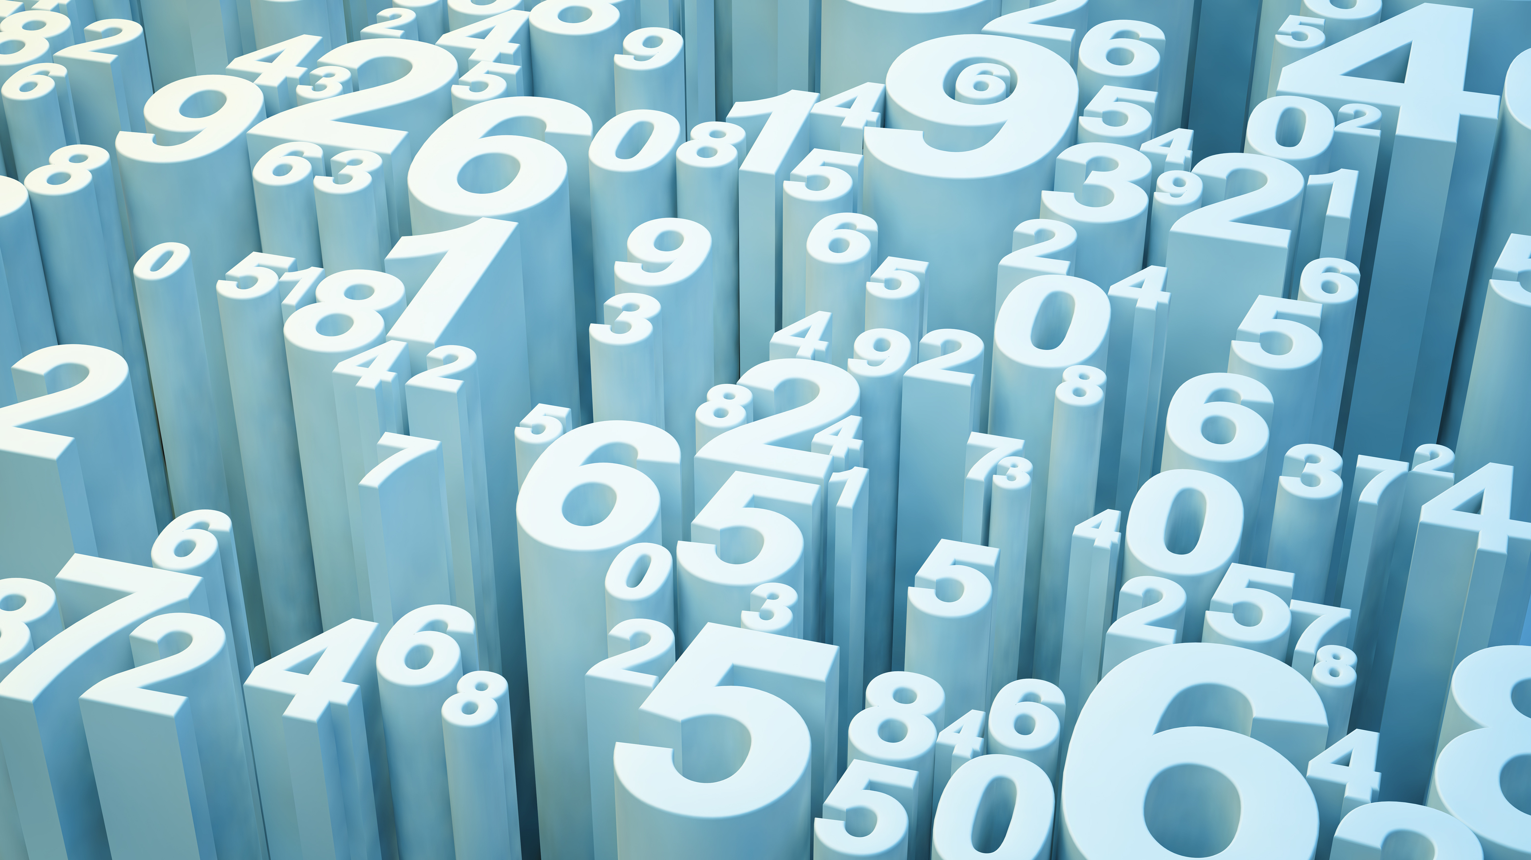
Housing Price Prediction Case Study

Slide 2
Problem Statement
Houses are one of the necessary need of each and every person around the globe and therefore housing and real estate market is one of the markets which is one of the major contributors in the world’s economy. It is a very large market and there are various companies working in the domain. Data science comes as a very important tool to solve problems in the domain to help the companies increase their overall revenue, profits, improving their marketing strategies and focusing on changing trends in house sales and purchases. Predictive modelling, Market mix modelling, recommendation systems are some of the machine learning techniques used for achieving the business goals for housing companies. Our problem is related to one such housing company. A US-based housing company named Surprise Housing has decided to enter the Australian market. The company uses data analytics to purchase houses at a price below their actual values and flip them at a higher price. For the same purpose, the company has collected a data set from the sale of houses in Australia. The data is provided in the CSV file below. The company is looking at prospective properties to buy houses to enter the market. You are required to build a model using Machine Learning in order to predict the actual value of the prospective properties and decide whether to invest in them or not. For this company wants to know:
• Which variables are important to predict the price of variable?
• How do these variables describe the price of the house?.

Slide 3
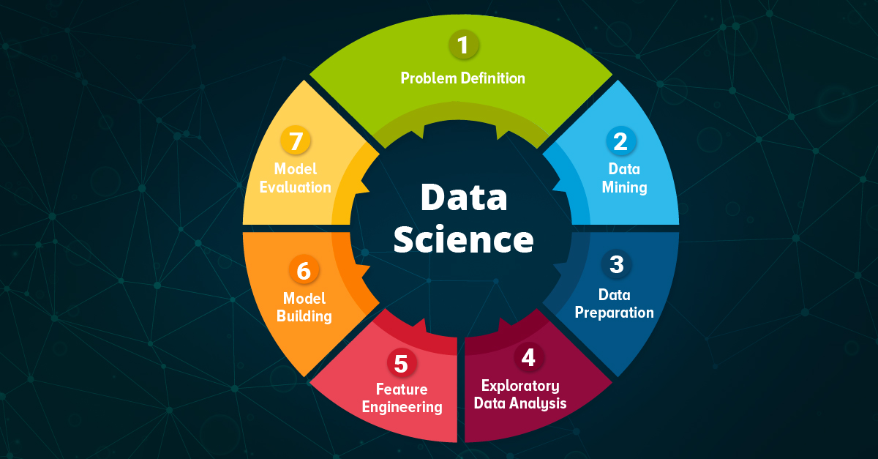
DATA SCIENCE

Slide 4
EDA(Exploratory Data Analysis) Steps
Exploratory Data Analysis is a data analytics process to understand the data in depth and learn the different data characteristics, often with visual means. This allows you to get a better feel of your data and find useful patterns in it.
Data Collection
Data Cleaning ( Handling Missing values & outliners)
3) Univariate Analysis (Bar graph)
4) Bivariate Analysis (Scatterplot, Pairplot, boxplot, Correlation Matrix)

Slide 5
Steps used for Analysis of Data
1)Loading the Data sets
2) Loading the file
3) Checking for the missing values or null values
4)EDA including plotting on graphs , correlation matrix
5) Checking the skewness
6) Removing the outliers
7) Undertaking the training process
8) Model building using various processes

